Slide 1
Machine Learning Approaches
to
Opinion Spam Detection
Yitong Chen & Yingqi Ding

Slide 2
What is opinion spam?
Fictitious opinions that have been deliberately written to sound authentic. (Ott et al. 2011)
Notes:
Define opinion spam:
fictitious opinions that have been deliberately written to sound authentic

Slide 3
Pop Quiz: which of the following review is deceptive?
My recent stay at the Amalfi Hotel in Chicago couldn't have gone worse. Apart from the price of staying there and the slow response time of hotel staff I was totally let down by the food that could be found there. There are many attractions in the area and indeed leaving the hotel is the best part of the experience.
When my husband and I went to Amalfi Hotel we were expecting first class service. First, when we got there we learned they had given our room to another guest and we were not able to get a suite like we had booked. Room service took forever and the food was subpar. Supposedly they had planners to help explore the area, but we requested one and never saw hide nor hair of a planner. The spa staff seemed incompetent. The only positive things I can say about Amalfi Hotel was that the rooms were stylish as advertised. I give this hotel two stars.
(data from Ott et al. 2011)
Notes:
Define opinion spam:
fictitious opinions that have been deliberately written to sound authentic

Slide 4
And the answer is …...
BOTH OF THEM!

Slide 5
Motivation and Goal
Machine vs. Human Performance
Humans are found to perform at chance (Ott et al. 2011) when asked to classify between truthful and deceptive reviews.
Neural network classifiers and SVM classifiers are found to classify at 90% accuracy (Ott et al. 2011, Ren and Ji 2017).
Goal: Comparative analysis of different models
Bi-directional Recurrent Convolutional Neural Network
Convolutional Neural Network
Support Vector Machine
Notes:
Machine vs. human: Yingqi
As we can feel intuitively, opinion spam detection, or imaginary writing in general, are very hard task even for human cognition. Some previous research has found that human perform at chance in classifying opinion spam. To be specific, the accuracy is about 45-60% in general. Thus the detection of opinion spam is definitely worth exploring. An interesting question to think about is that can machine be able to detect such writings? Even better than human? And the answer is yes. Studies have shown that models such as neural network and support vector machine achieve accuracy around 90%.
Goal: Yitong
The goal of our project is to implement different machine learning models and to train them to classify truthful and deceptive reviews. We compare the performance between three different models: the bi-directional RCNN, CNN without the recurrent layer and the SVM classifier that we did not cover in class. We will now introduce these models one-by-one and explain why they are expected to be a good choice for this task.

Slide 6

Bi-directional Recurrent Convolutional Neural Network
(Adapted from Lai et al. 2015)
Notes:
Yitong
Start with the one with the longest name :) The network can be basically divided into two parts, the bi-directional recurrent layers and the convolutional neural net.

Slide 7
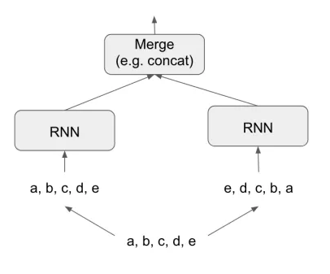
Bi-directional Recurrent Layers - Word Encoding
Process the input sequence in two directions.
More comprehensive encoding of contextual information.
→ Compare between
“He said, Teddy bears are on sale.”
“He said, Teddy Roosevelt was a great president.”
(Chollet and Allaire 2018, Figure 6.21)
Notes:
Yitong
The bi-directional RCNN is similar to the RNN we are familiar with, except that it can process the input sequence in two directions. As shown in the picture, we can think of the bi-directional RNN as a combo of two RNNs, one for processing in forward order and the other for reversed order.
The reason for using bi-directional is because it captures more contextual information that is critical for semantic encoding. With only the preceding context, the model cannot distinguish between Teddy as in Teddy bear and Teddy as in Teddy Roosevelt.

Slide 8
Convolutional Network - Text Encoding
The Max Pooling layer picks out the most significant semantic factors in a sequence of words.
The fully connected layer compiles the information into activations on two output nodes o₀ and o₁ .
My recent stay at the Amalfi Hotel in Chicago couldn't have gone worse. Apart from the price of staying there and the slow response time of hotel staff I was totally let down by the food that could be found there. There are many attractions in the area and indeed leaving the hotel is the best part of the experience.
(Ott et al. 2011)
Notes:
The output of bi-directional RNN is the semantic encoding of words, which will be fed into a max pooling layer to pick out the most significant semantic factors. As human readers, we are able to scan through a piece of text and select the keywords that define the semantic core. The max pooling layer does exactly that for the network.
The fully connected layer compiles these semantic factors and transforms into activation on two output nodes. Higher activation on o0 means deceptive and higher activation on o1 means truthful.

Slide 9
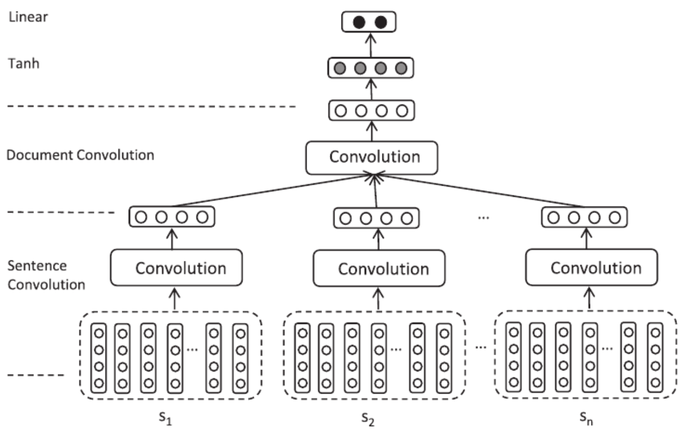
Convolutional Neural Network
without recurrent layers
Compare to bi-directional RCNN
Implementation of Li, Qin, Ren and Liu (2016) of the model
Sentence → Conv Layer → Word Embedding
2 convolutional layers
semantic meaning → local features
sentence convolution
document convolution
Li, Qin, Ren and Liu (2016)
Notes:
Yingqi
The first layer makes a composition of each sentence using a fix-length window, while the second layer transforms vectors of the sentences into a vector of document.

Slide 10
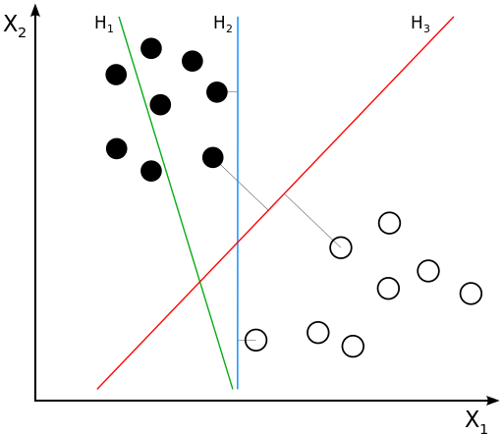
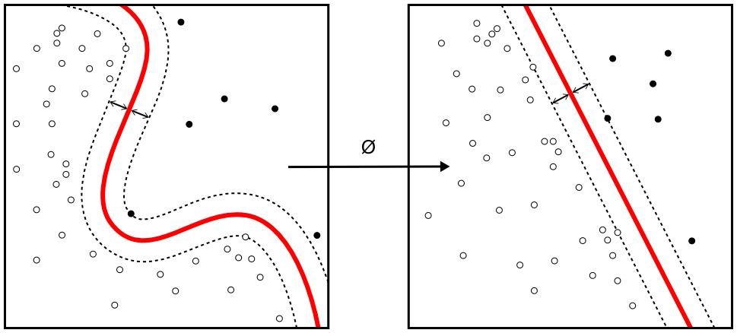
Support Vector Machine
Supervised Learning
Data Point
p-dimensional vector
separate data points with a (p-1)-dimensional hyperplane
Best Hyperplane
the largest separation between classes
larger separation/margin → lower error
Efficient for both linear and non-linear classification in general.
(https://en.wikipedia.org/wiki/Support_vector_machine)
Notes:
Yingqi
To keep the computational load reasonable, the mappings used by SVM schemes are designed to ensure that dot products of pairs input data vectors may be computed easily in terms of the variables in the original space

Slide 11
Results - Best Classification Accuracy
 | Training Data | Testing Data
RCNN | 92.43% | 85.2%
SCNN | 100% | 83.5%
SVM | 94.3% | 77.8%
Notes:
Yitong
Our data set contains 1600 pieces of reviews in total, half of which are deceptive and the other half are truthful. We divide the data into training and testing sets and run simulations using each of the three models.
Here’s part of result. All three models reach more than 90% accuracy for categorizing training data. For testing data, the RCNN performs the best, but there is not a significant difference between the models.

Slide 12
Conclusion
The machine learning models perform better than humans.
There is no clear difference in performance between the neural network classifier and the SVM classifiers in terms of accuracy, but the SVM classifier is easier to implement and faster to train.
The models can be further improved:
More training data for neural networks.
More features for SVMs.
Notes:
Yitong

Slide 13
References
Chollet, F., & Allaire, J.J. (2018) Deep Learning with R. Manning Publication. Greenwich, CT, USA.
Lai, S., Xu, L., Liu, K., & Zhao, J. (2015). Recurrent convolutional neural networks for text classification. In Proceedings of the twenty-ninth AAAI conference on artificial intelligence (pp. 2267–2273).
Li, L., Qin, B., Ren, W., & Liu, T. (2017). Representation and feature combination for deceptive spam review detection. ScienceDirect Neurocomputing journal, 33-41
Ott, M., Choi, Y., Cardie, C., & Hancock, J. T. (2011). Finding deceptive opinion spam by any stretch of the imagination. Proceedings of the 49th Annual Meeting of the Association for Computational Linguistics, 309-319.
Ren, Y., & Ji, D. (2017). Neural networks for deceptive opinion spam detection: An empirical study. Information
Sciences, 385-386, 213-224. doi: 10.1016/j.ins.2017.01.015.
Support Vector Machine. https://en.wikipedia.org/wiki/Support_vector_machine. Retrieved on 11/18/2018.

Slide 14
Thank You for Listening!
Questions?

